Slide 1
128 77 26
172 102 187
165 0 33
153 51 102
51 153 102
222 108 54
249 182 57
51 102 153

Slide 3
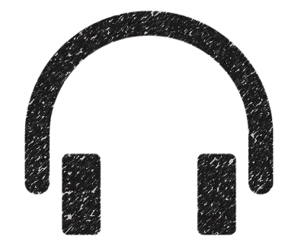
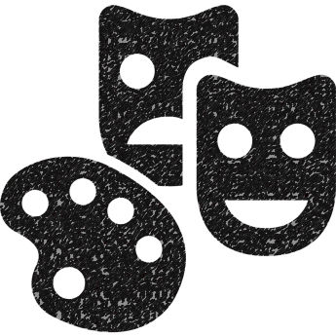
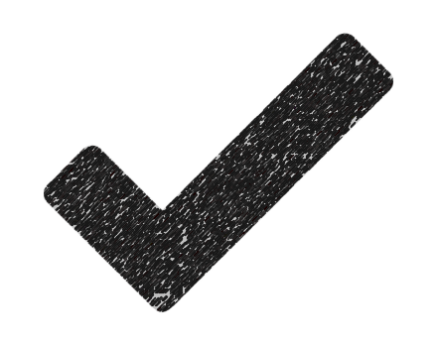

Slide 7
https://thenounproject.com/term/headphones/7443/
https://thenounproject.com/term/book/3688/
https://thenounproject.com/term/speech-bubble/116096/
https://thenounproject.com/term/conversation/91593/
https://thenounproject.com/term/pencil/11202/
https://thenounproject.com/term/eye/6411/
https://thenounproject.com/term/arts-and-culture/13644/
https://thenounproject.com/term/check-mark/8831/

